Slide 1


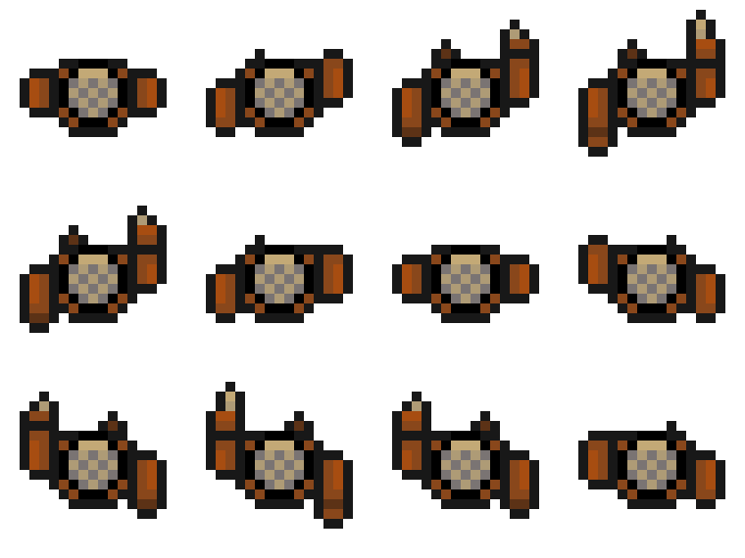
Group 9
Willoughby Axtell, Bailey Keeble, Ethan Probert, Lewis Arnold

Slide 2

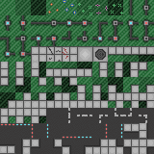

Brief Key Points
Removing main mechanic from a genre of game of our choice
Finding a new way to tackle the problem that was caused by removing the original mechanic from the genre of game
Replacing the old mechanic with a new and refined solution that is easy for the player to understand and play.

Slide 3


Brief Response
Top Down Shooter with Shooting mechanic removed
Replaced with manoeuvring between enemies to make them shoot each other
Fast Paced Twitch mechanic to keep the player on their toes and always moving the character.
Attempting to achieve hard fun with players trying to manoeuvre quick enough to not be shot but also make the enemies shoot one another

Slide 4
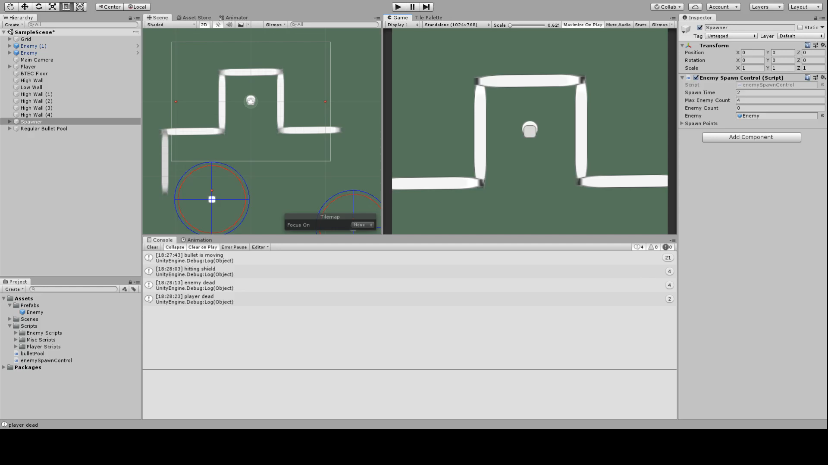
Video Walkthrough

Slide 5


Final Deliverables
At least 5 Complete and polished levels which use our bullet avoiding mechanic in creative and unique ways.
Full roster of sound and visual effects which help communicate what is going on
Create a variety of enemy layouts

Slide 6
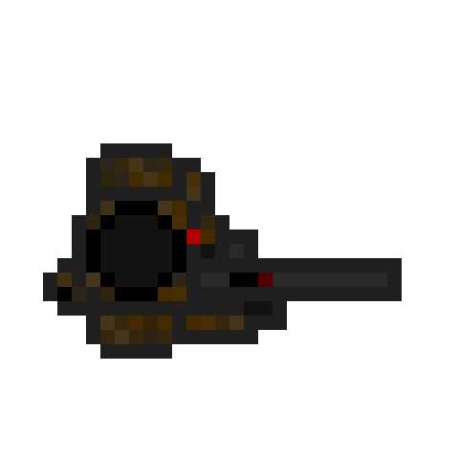
Any Questions?

